Slide 1

Java 21 New Features
Dima Ionut Daniel

Slide 2
Contents
What is Java?
History
Java Flavors
New Features
Core
Other Improvements
Bibliography

Slide 3

What is Java?
Java is a programming language created by Sun Microsystems.
Java is used in a wide variety of computing platforms from embedded devices and mobile phones on the low end, to enterprise servers and supercomputers on the high end.
Memory management is handled through integrated automatic garbage collection performed by the JVM.
The heart of the Java platform is the concept of a "virtual machine" that executes Java bytecode programs. This bytecode is the same no matter what hardware or operating system the program is running under.
There is a JIT(Just-In-Time) compiler within the Java Virtual Machine, or JVM. The JIT compiler translates the Java bytecode into native processor instructions at run-time and caches the native code in memory during execution.
The Java programs are cross-platform or platform independent, but the code of the Java Virtual Machines (JVM) that execute these programs is not.

Slide 4
History
The initial Java release was named Oak, and the first stable version was JDK 1.0.2, called Java 1.
JDK 1.0 - 23 January 1996
JDK 1.1 – 19 February 1997
J2SE 1.2 – 8 December 1998 (codename Playground)
J2SE 1.3 – 8 May 2000 (codename Kestrel)
J2SE 1.4 – 6 February 2002 (codename Merlin)
J2SE 5.0 – 30 September 2004 (codename Tiger)
Java SE 6 – 11 December 2006 (codename Mustang)
Java SE 7 – 7 July 2011(codename Dolphin)
Java SE 8 – 18 March 2014 (codename Spider)
Java SE 9 – 21 September 2017
Java SE 10 – 20 March 2018

Slide 5
History (cont.)
Java SE 11 – 25 September 2018
Java SE 12 – 19 March 2019
Java SE 13 – 17 September 2019
Java SE 14 – 17 March 2020
Java SE 15 – 16 September 2020
Java SE 16 – 16 March 2021
Java SE 17 – 14 September 2021
Java SE 18 – 22 March 2022
Java SE 19 – 20 September 2022
Java SE 20 – 21 March 2023
Java SE 21 – 19 September 2023

Slide 6
Java Flavors
The Java distribution comes in different flavors:
Java Card →run securely on smart cards and similar small-memory devices.
Java ME(Micro Edition) → Specifies several different sets of libraries (known as profiles) for devices with limited storage, display, and power capacities.
Java SE(Standard Edition) → for general-purpose use on desktop PCs, servers and similar devices.
Java EE(Enterprise Edition) → Java SE plus various APIs useful for multi-tier client–server enterprise applications.

Slide 7
New Features
JEP 420: Pattern Matching for “switch” (Preview)
JEP 425: Problem List
JEP 429: Record Patterns (Preview)
JEP 430: String Templates (Preview)
JEP 431: Sequenced Collections
JEP 442: Foreign Function & Memory API (Third Incubator)
JEP 444: Virtual Threads
JEP 446: Scoped Values (Preview)
JEP 448: Vector API (Fifth Incubator)
JEP 452: Key Encapsulation Mechanism API
JEP 453: Structured Concurrency (Incubator)

Slide 8
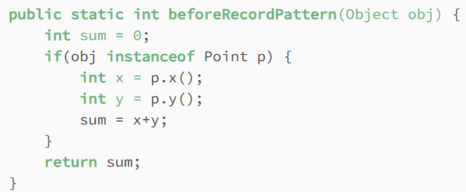
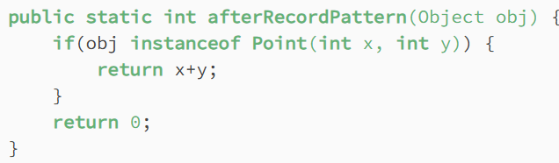
Core
Record patterns (JEP 440) were included in Java 19 and Java 20 as preview features.
With Java 21, they are out of the preview and include some refinements.
This JEP extends the existing pattern-matching feature to destructure the record class instances, which enables writing sophisticated data queries.

Slide 9
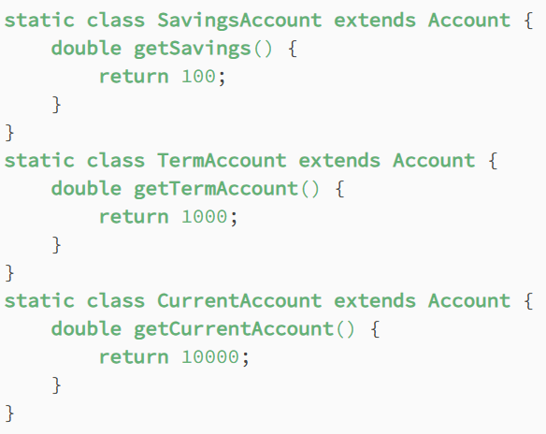
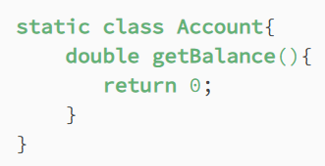
Core (cont.)
The "Pattern Matching for switch" (JEP 441) was introduced in JDK 17.
Pattern matching for the switch was refined in JDK 18, 19, and 20 and improved further in JDK 21.
The main goal of this feature is to allow patterns in switch case labels and improve the expressiveness of switch statements and expressions. Besides, there is also an enhancement to handle NullPointerException by allowing a null case label.

Slide 10
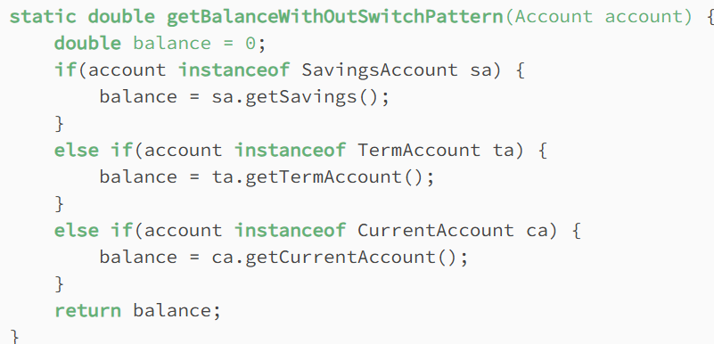
Core (cont.)
Before Java 21:

Slide 11
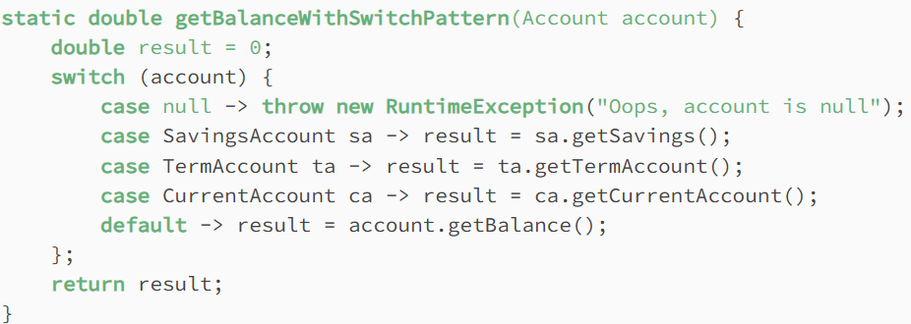
Core (cont.)
With Java 21, we can leverage patterns in case labels to write the same logic more concisely.

Slide 12
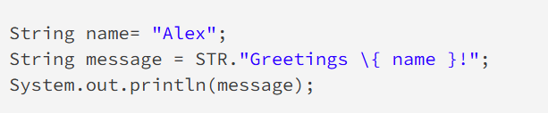
Core (cont.)
Java 21 introduces string templates. It complement Java’s existing string literals and text blocks by coupling literal text with template expressions and template processors to produce the desired results.
String templates goals:
simplify the process of expressing Strings with values that can be compiled at run time
enhanced readability of String compositions, overcome the verbosity associated with StringBuilder and StringBuffer classes
overcome the security issues of the String interpolation techniques that other programming languages allow, trading off a small amount of inconvenience
allow Java libraries to define custom formatting syntax of the resulting String literal

Slide 13
Core (cont.)
A template processor is responsible for evaluating the embedded expression (the template) and combining it with the String literal at runtime to produce the final String. This is a preview feature in Java 21; therefore, we’d have to enable preview mode.
Java provides some out-of-the-box template processors.
The STR Template Processor performs string interpolation by iteratively replacing each embedded expression of the provided template with the stringified value of that expression.
Another Java-provided processor is the FMT Template Processor. It adds the support of understanding the formatters that are provided to the processor, which format the data according to the formatting style provided.

Slide 14
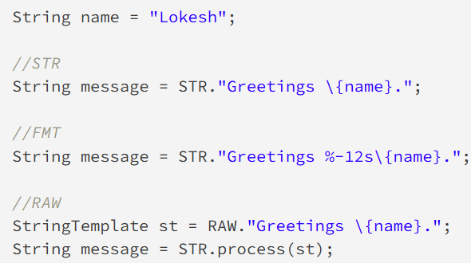
Core (cont.)
Java 21 supports 3 template processors:
STR: performs the standard interpolation.
FMT: performs interpolation, as well as interprets the format specifiers which appear to the left of embedded expressions
RAW: is a standard template processor that produces an unprocessed StringTemplate object.

Slide 15
Core (cont.)
The "Virtual Threads" (JEP 444) feature was initially introduced to the Java language as a preview feature in Java 19 and further refined in Java 20. Java 21 introduced some new changes.
Virtual threads are lightweight threads with the purpose of reducing the effort of developing high-concurrent applications.
Traditional threads, also called platform threads, are thin wrappers around OS threads. One of the major issues with platform threads is that they run the code on the OS thread and capture the OS thread throughout its lifetime. There is a limit to the number of OS threads, and this creates a scalability bottleneck.
Like platform threads, a virtual thread is also an instance of java.lang.Thread class, but it isn’t tied to a specific OS thread. It runs the code on a specific OS thread but does not capture the thread for an entire lifetime. Therefore, many virtual threads can share OS threads to run their code.

Slide 16
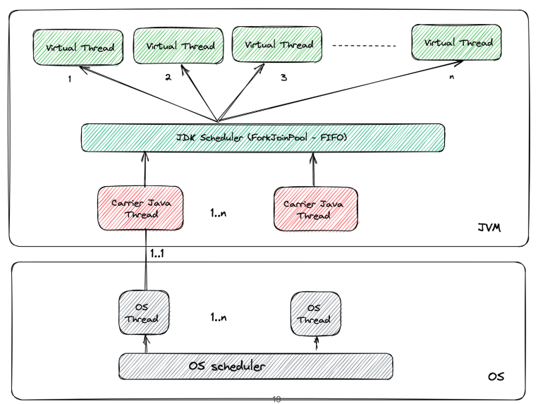
Core (cont.)

Slide 17
Core (cont.)
Benefits:
Lightweight: minimal memory overhead, allowing for the creation of large numbers of threads without exhausting system resources.
Structured Concurrency: promote structured concurrency, which helps developers write more reliable and maintainable concurrent code. By enforcing clear boundaries and lifecycles for concurrent tasks, structured concurrency simplifies error handling and resource management.
Improved Scalability: developers can achieve higher scalability and throughput compared to traditional threads. The JVM’s scheduler efficiently manages virtual threads, ensuring optimal utilization of system resources.
Integration with CompletableFuture: seamless integration between Virtual Threads and CompletableFuture, simplifying asynchronous programming.

Slide 18
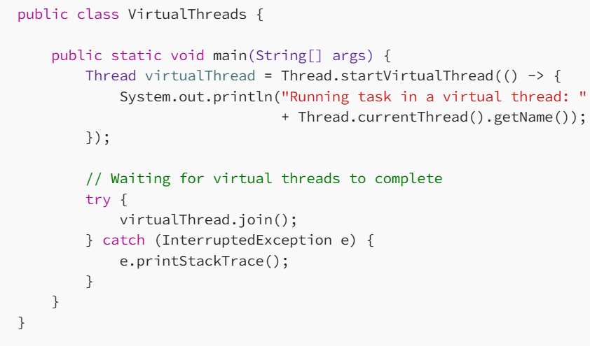
Core (cont.)
Java 21 introduced two notable changes to the virtual threads:
Virtual threads now always support thread-local variables.
Virtual threads are created through the Thread.Builder APIs are also monitored through their lifetime and observable in the new thread dump.

Slide 19
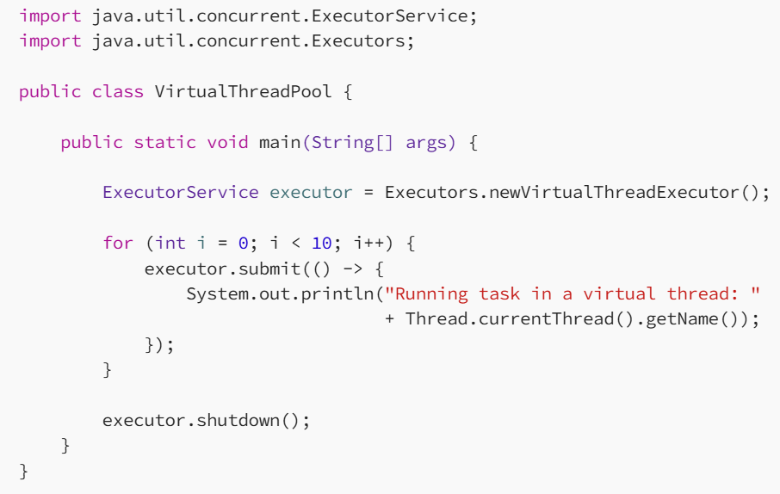
Core (cont.)
Using virtual thread pool example:

Slide 20
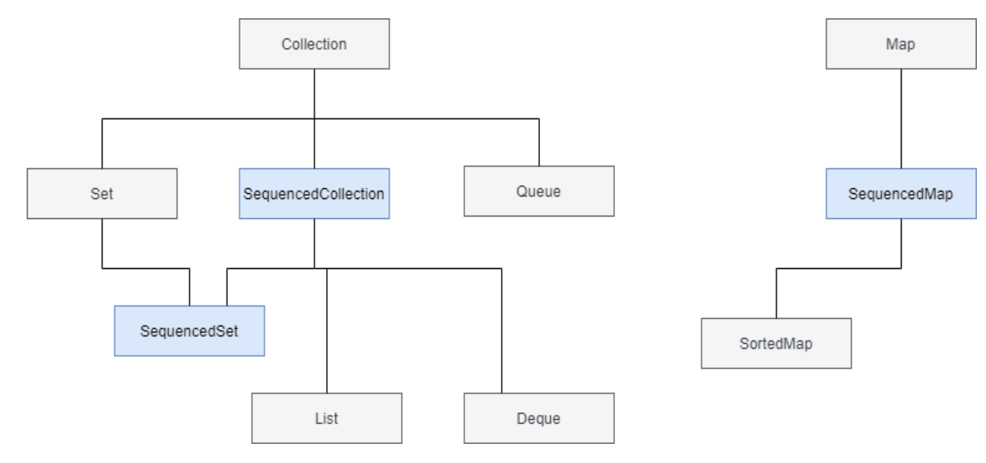
Core (cont.)
Java 21 introduced three new interfaces to represent sequenced collections (JEP 431), sequenced sets, and sequenced maps.
A sequenced collection is a collection whose elements have a defined encounter order. It has first and last elements, and the elements between them have successors and predecessors. A sequenced set is a set that is a sequenced collection with no duplicate elements. A sequenced map is a map whose entries have a defined encountered order.

Slide 21
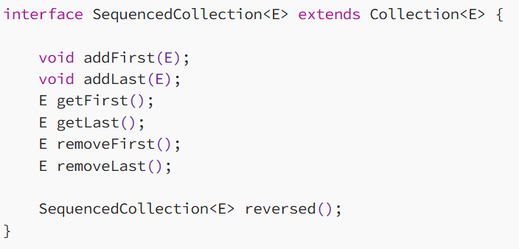
Core (cont.)
The interface SequencedCollection introduced new methods

Slide 22
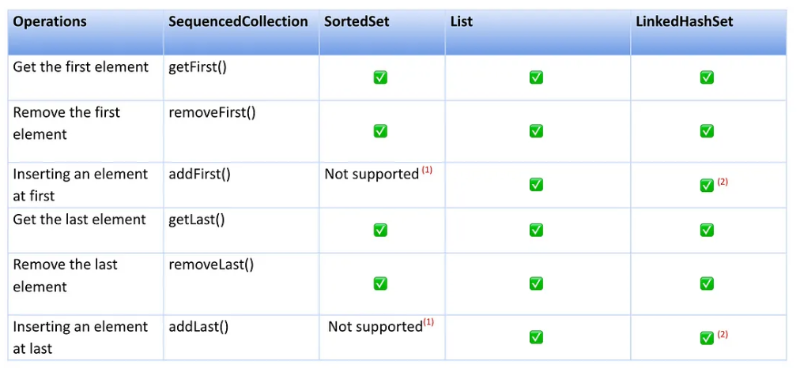
Core (cont.)
The new reversed() method provides a reversed order view of the original collection.

Slide 23
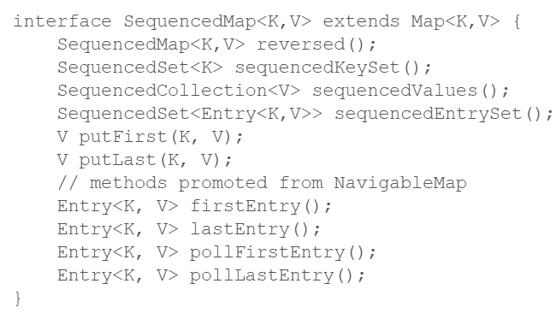
Core (cont.)
A SequencedMap provides methods to add mappings, to retrieve mappings, and to remove mappings at either end of the map's encounter order.

Slide 24
Core (cont.)
Key encapsulation is a technique to secure symmetric keys using asymmetric keys or public key cryptography.
The traditional approach uses a public key to secure a randomly generated symmetric key. However, this approach requires padding, which is difficult to prove secure.
A key encapsulation mechanism (KEM) (JEP 452) uses the public key to derive the symmetric key that doesn’t require any padding.
Java 21 has introduced a new KEM API to enable applications to use KEM algorithms.

Slide 25
Core (cont.)
Goals:
Security: KEM helps protect keys during exchange, minimizing the risk of eavesdropping or interception by malicious actors. This is crucial for maintaining the confidentiality and integrity of sensitive data.
Flexibility: The KEM API in Java 21 supports various KEM algorithms, ensuring that developers can choose the one that best suits their application's requirements.
Ease of Use: Java's KEM API simplifies key management by abstracting many of the low-level cryptographic operations, making it more accessible for developers

Slide 26
Core (cont.)
The Foreign Function & Memory API (JEP 442), introduced in Java 21 as a preview feature, provides a mechanism for Java programs to interoperate with code and data outside of the Java runtime environment. This is particularly useful for calling native libraries written in languages like C or C++ and for working directly with native memory in a safe and efficient manner.

Slide 27
Core (cont.)
Calling Native Functions:
The API allows you to define native functions in a type-safe manner, eliminating the need for JNI (Java Native Interface) boilerplate code.
You can declare and call native methods with defined signatures, which helps in reducing errors associated with incorrect type mappings.
Direct Access to Native Memory:
The API provides ways to allocate, manipulate, and free native memory directly from Java. This circumvents the need for traditional heap memory and allows more efficient data handling.
Native memory can be managed using a set of structured APIs, enabling operations like reading/writing byte buffers directly without JVM overhead.
Memory Segments:
The concept of "memory segments" is introduced, which represent a region of native memory. They can be created and manipulated, and they provide a way to group multiple memory allocations together.
This helps manage resources effectively, especially in scenarios where memory needs to be allocated and dealt with in chunks.

Slide 28
Core (cont.)
Type Safety:
The API employs an advanced type system to ensure that you can define the layout of native data structures in a Java-friendly manner.
You can map native types to Java types using MemoryLayouts, which define the structure of memory layouts for native uses.
Async and Native Libraries:
The API supports async calls when integrating with native libraries, allowing you to perform non-blocking operations while invoking native code.
This is particularly useful for modern applications that require high performance and responsiveness.
Interoperability:
With the Foreign Function & Memory API, it becomes simpler to interact with config-driven libraries, system libraries, and operating system APIs.

Slide 29
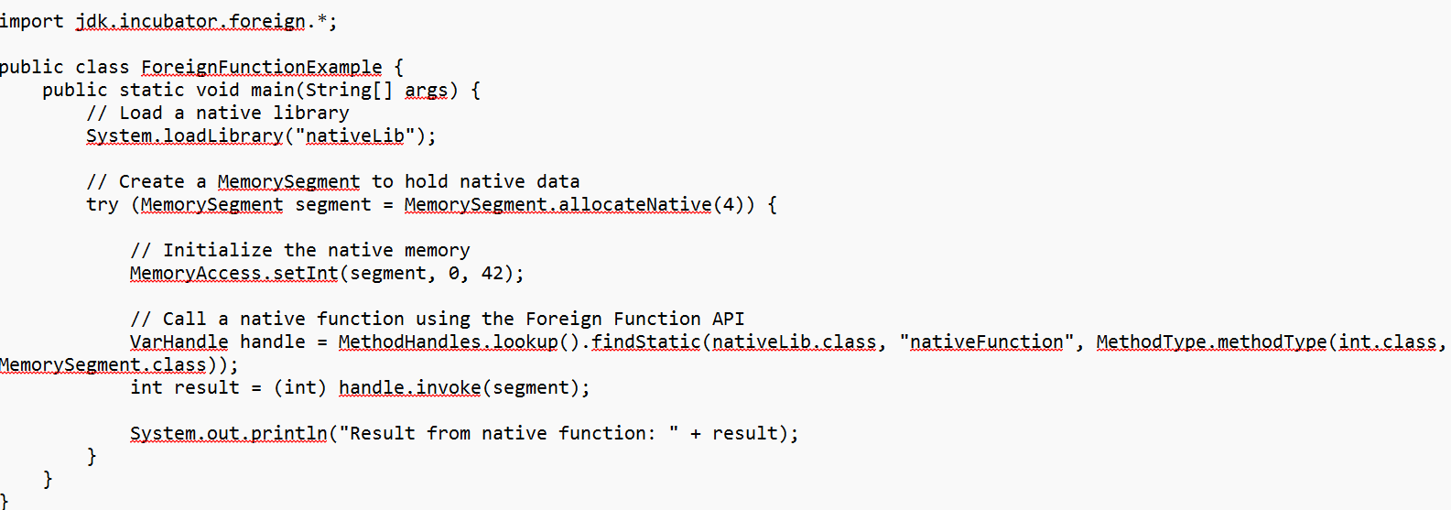
Core (cont.)

Slide 30
Core (cont.)
The Vector API in Java is a feature that was introduced as an incubating feature in Java 16 and has been evolving since then. In Java 21, the Vector API allows developers to express vectorized computations, which can help in performing operations on arrays of data more efficiently compared to traditional scalar operations. The full java package is jdk.incubator.vector.
Objectives:
Performance: enable applications to leverage the most powerful vector hardware instructions on modern processors
Portability/Clarity: offer a portable API that can execute on various CPU architectures without needing architecture-specific code.
Graceful Degradation: ensure that the API degrades gracefully

Slide 31
Core (cont.)
Structured concurrency (JEP 453) is a programming concept that aims to simplify the management of concurrent tasks in an application, making it more intuitive and less error-prone. Introduced in Java 21, it provides a more structured approach to concurrency, as opposed to traditional threading models which can lead to complicated and difficult-to-manage code.

Slide 32
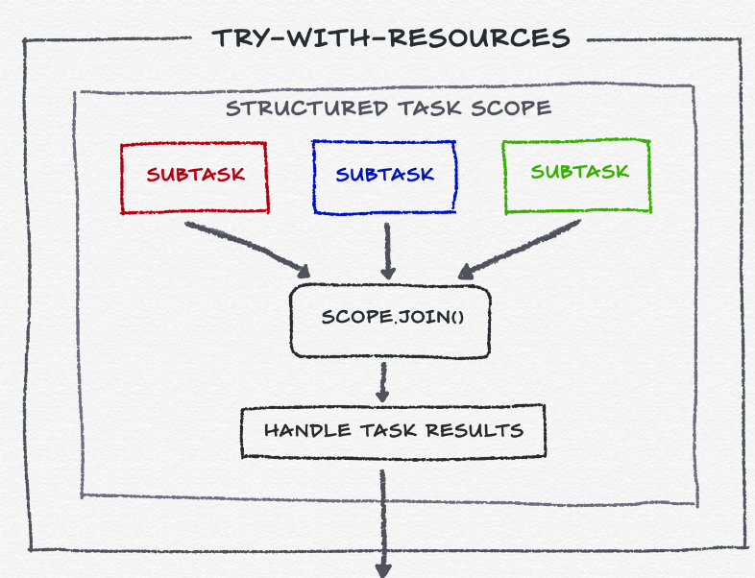
Core (cont.)

Slide 33
Core (cont.)
Hierarchical Task Management:
In structured concurrency, tasks are organized in a tree-like hierarchy.
When a parent task is completed or canceled, all child tasks are also terminated.
This makes it easier to manage the lifecycle of concurrent tasks.
Error Propagation:
Errors and exceptions from child tasks can be propagated to the parent task or collected for handling after all tasks have completed.
This helps in better error handling and debugging.
Resource Management:
Resources can be more easily managed and released, as structured concurrency encourages scoping of task lifetimes.
This can help prevent resource leaks.
Clearer Code:
Structured concurrency promotes clearer and more readable code by encapsulating concurrency logic within well-defined scopes, leading to reduced complexity.

Slide 34
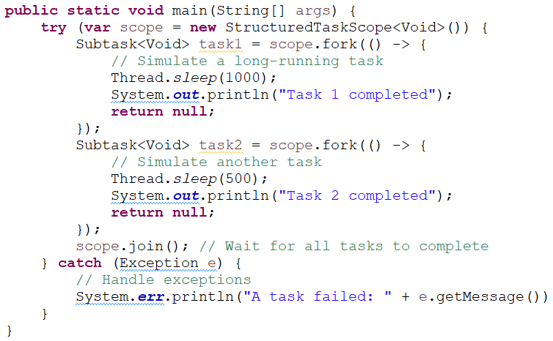
Core (cont.)

Slide 35
Core (cont.)
To create a scope, we need to create a new StructuredTaskScope<T> instance, either by using it directly or one of its subclasses:
StructuredTaskScope<T>()
StructuredTaskScope.ShutdownOnSuccess()
StructuredTaskScope.ShutdownOnFailure()

Slide 36
Core (cont.)
The two subclasses implement a policy on how subtask completion affects the scope.
StructuredTaskScope.ShutdownOnSuccess captures the first successfully completed subtask result and shuts down the scope afterward. This will interrupt any unfinished threads and wake up the scope’s owner. Choose this policy if you only need the result of a singular subtask (“invoke any”).
StructuredTaskScope.ShutdownOnFailure is the opposite, as it shuts down the scope on the first failed subtask. If you require all results (“invoke all”), this policy ensures that other subtasks get discarded if any of them fails.
Of course, we can create our own policy if needed by extending StructuredTaskScope<T> and overriding some of its methods, like handleComplete(Subtask).

Slide 37
Core (cont.)
The Scoped Values (JEP 446) feature aims to provide a mechanism for managing data that has a specific lifespan and scope, allowing for a more structured way to handle values that are relevant only within a given context (such as a request or a thread).
These are values that you can set and retrieve within a defined scope.
Each value is tied to a particular region of code, enabling the passage of data without relying on parameters or global state.
The main class introduced is "ScopedValue", which offers a way to create scoped values.
The values are scoped within a certain context (like a thread or a request). The JEP handles the propagation of these values through different execution contexts.
Once you exit the defined scope, the values are automatically cleared, preventing memory leaks and ensuring that data is not mistakenly shared between unrelated operations.

Slide 38
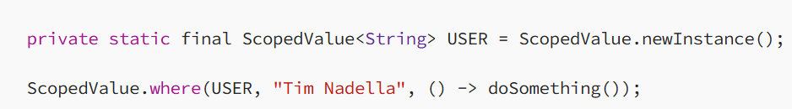
Core (cont.)
Scoped values enable safe and efficient sharing of immutable data between components without resorting to method arguments. They were developed together with virtual threads and structured concurrency as part of the project Loom.
Example:
Code executed within doSomething() that invokes USER.get() will read the value “Tim Nadella”. The scoped value is bound while executing doSomething() and becomes unbound when doSomething() completes (normally or with an exception).

Slide 39
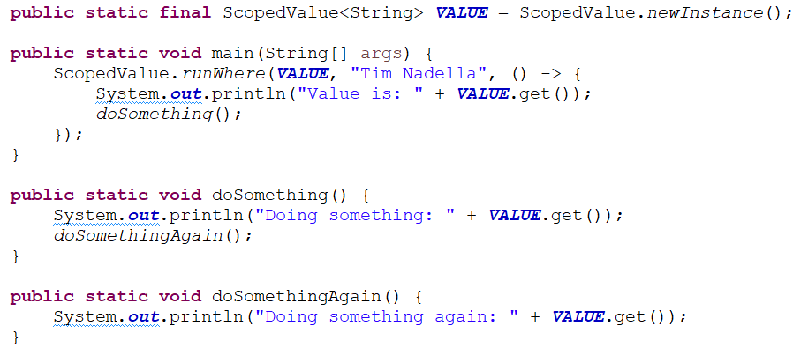
Core (cont.)

Slide 40
Other Improvements
Improve application performance by extending the Z Garbage Collector (ZGC) to maintain separate generations for young and old objects. This will allow ZGC to collect young objects, which tend to die young, more frequently. What Generational ZGC Means:
Generational Concept: Generational garbage collection is based on the observation that most objects are short-lived. By categorizing objects into generations (typically "young" and "old"), the garbage collector can optimize the collection process: it collects the young generation more frequently (where most collectibles reside) and less frequently collects the older generation.
Performance Improvements: By introducing a generational aspect, ZGC can potentially improve performance by reducing the amount of time spent in garbage collection. Since most allocations are short-lived, the young generation can be cleaned up more frequently without needing to touch the more stable old generation.
Scalability: Generational ZGC aims to support applications with a large heap size while maintaining the low-latency advantages of ZGC. It endeavors to bring the benefits of generational GC into an already scalable and reliable framework.
ZGC Algorithms Change: The addition of generational handling likely involves changes to the underlying algorithms that make decisions on when to perform collections, how to promote objects between generations, and where to focus the GC activity.

Slide 41
Other Improvements (cont.)
To enable the usage of Generational ZGC, we need to pass 2 VM arguments: -XX:+UseZGC –XX:+ZGenerational .

Slide 42

Bibliography
http://en.wikipedia.org/wiki/Java_(programming_language)
https://www.oracle.com/java/technologies/javase/21-relnote-issues.html
https://www.baeldung.com/java-lts-21-new-features
https://howtodoinjava.com/java/java-string-templates/
https://www.javatpoint.com/key-encapsulation-mechanism-api-in-java-21
https://belief-driven-design.com/looking-at-java-21-structured-concurrency-39a81/

